Slide 1




Bike sales
Graduation project 2024
Presented By:
Ebrahim Magdy
Dina Hani
Mai Mohamed
Alaa Sadek
Amr Zakaria
Mina Nabil
Eng. Menna Selim
CAI1_DAT1_G10d
DATA STARS TEAM

Slide 2

Overview
About the project
Objectives
Tools
Modeling
Insights &visuals

Slide 3

The goal is to provide the bike store with accurate, real-time insights into its operations and help management make data-driven decisions to optimize revenue and efficiency.

Slide 4

Objective
A growing bike store aims to manage its operations by implementing a relational database system. It sells a variety of bikes and accessories. The business needs to analyze sales, manage inventory, handle customer orders, and ensure the smooth of day-to-day transactions.

Slide 5



Tools
First, we used SQL to clean the data and transfer it to queries. Then, we used Power BI to visualize our queries and gain insights.

Slide 6
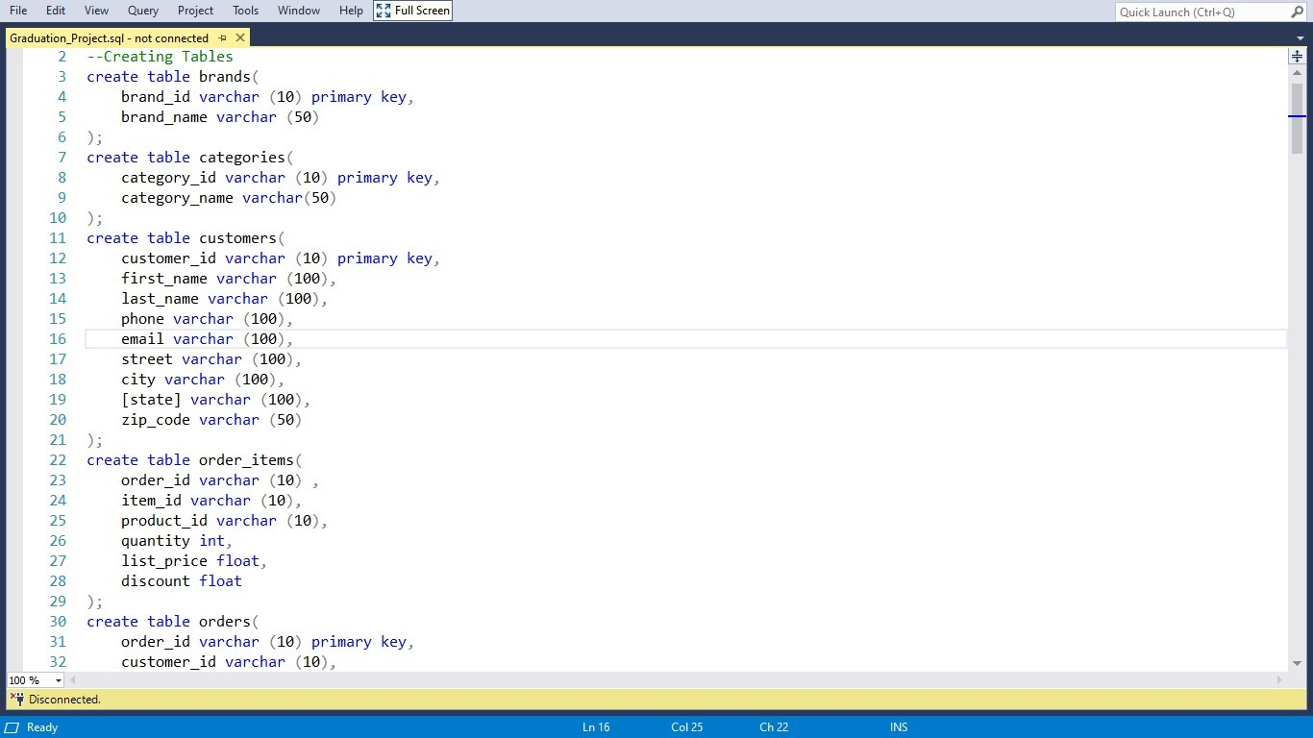
SQL
We used SQL to create structured tables to organize and store data efficiently for analysis.

Slide 7
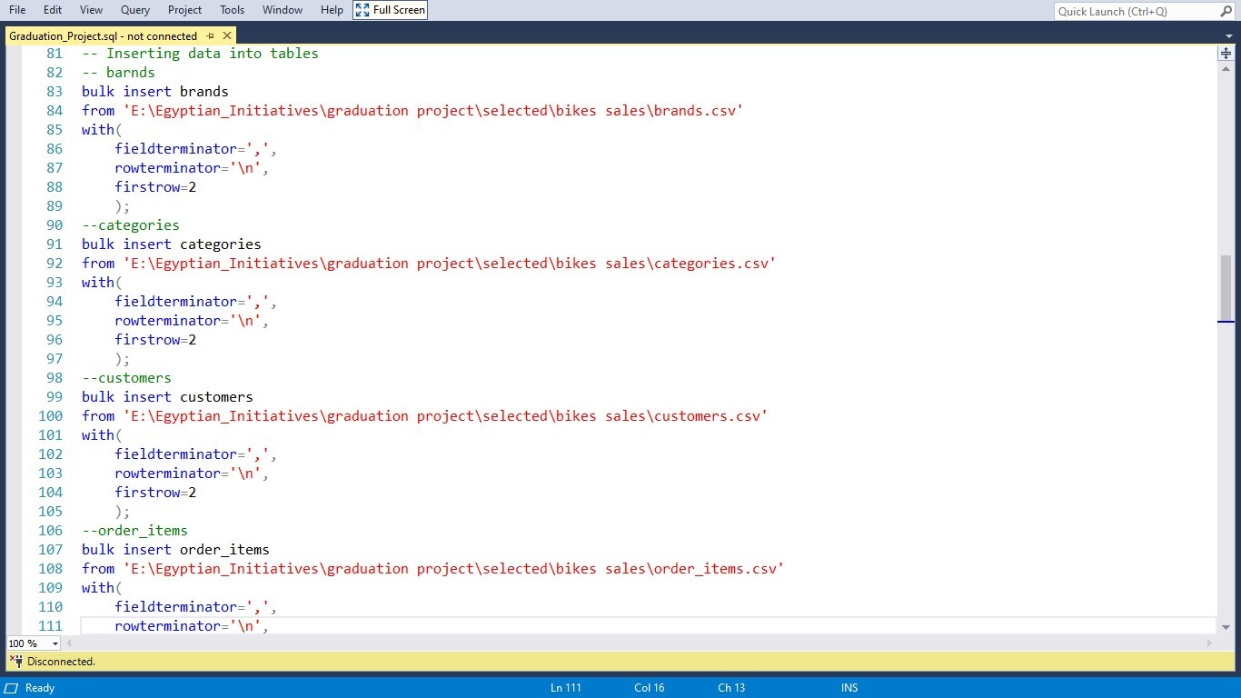
SQL
Then we implement a bulk insert statement to efficiently populate the tables with large datasets.

Slide 8
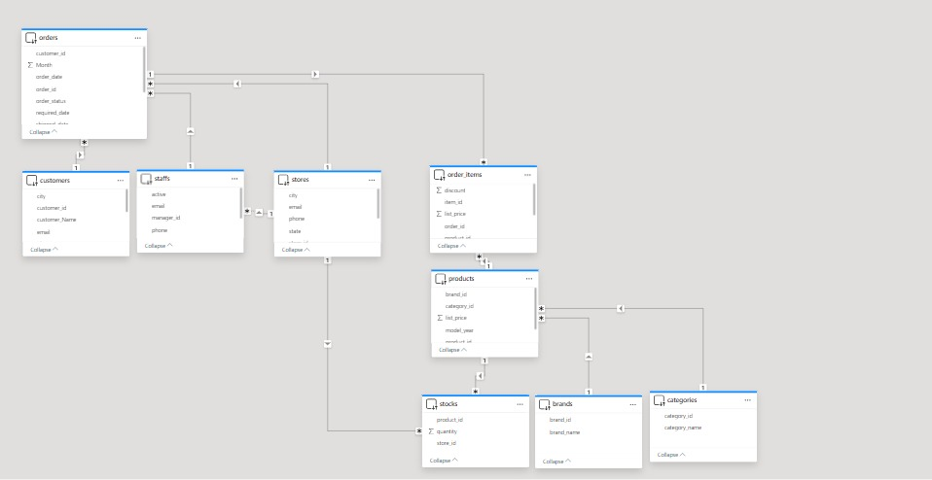
Data Modeling
We used snowflake schema with orders as fact table, relations between tables are created based on primary and secondary keys.

Slide 9
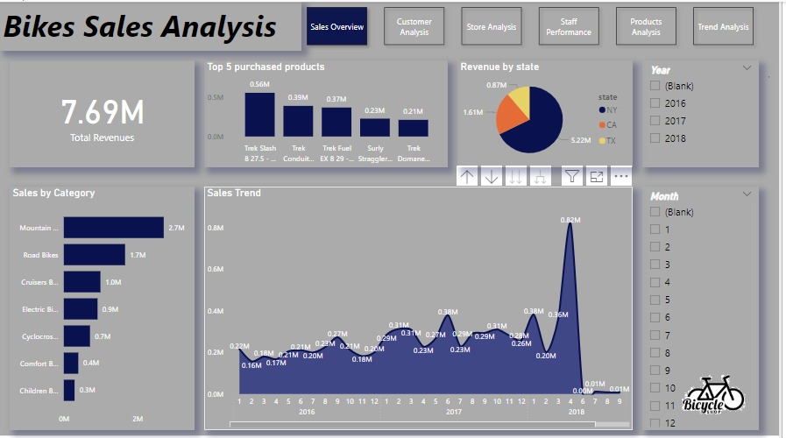
SALES
Starting with sales overview, showing the total sales ,
top 5 product sold ,
sales for each category, sales trend over time.

Slide 10
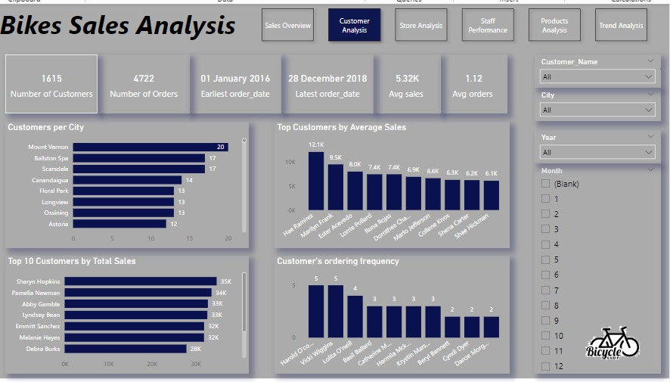
Customer transactions
Moving to customer analysis, showing and analyzing the transactions made by customers, the most buying, most spending, also how loyal our customer is.

Slide 11
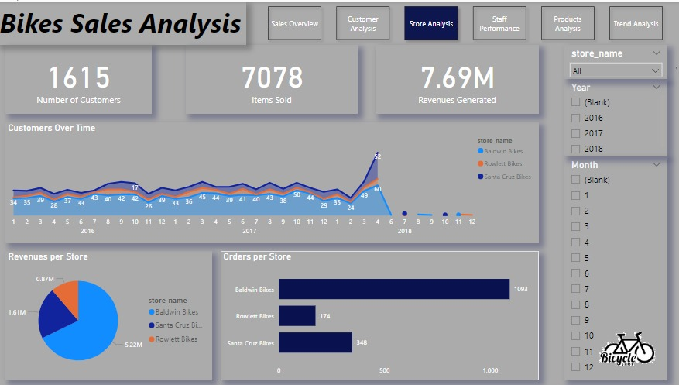
Our Stores
Comparing the performance of our stores based on previously defined KPIs such as:
1-Customers attracted
2-Itmes Sold
3-Orders Made
4-Revenues Generated

Slide 12
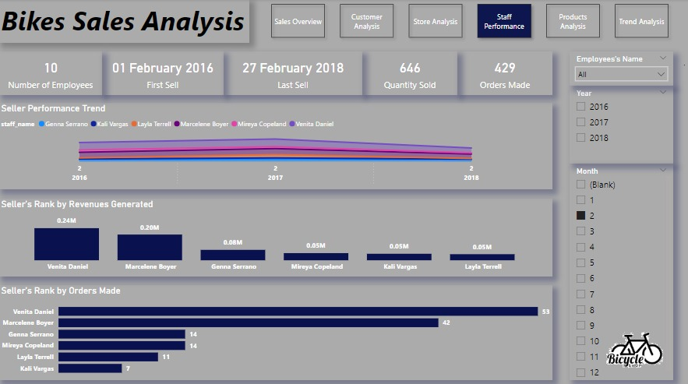
Staff Performance
Defining our top-rated Employees through selling rate, deals made, revenues generated, also a glance over time to track the contribution for every person to the success achieved.

Slide 13
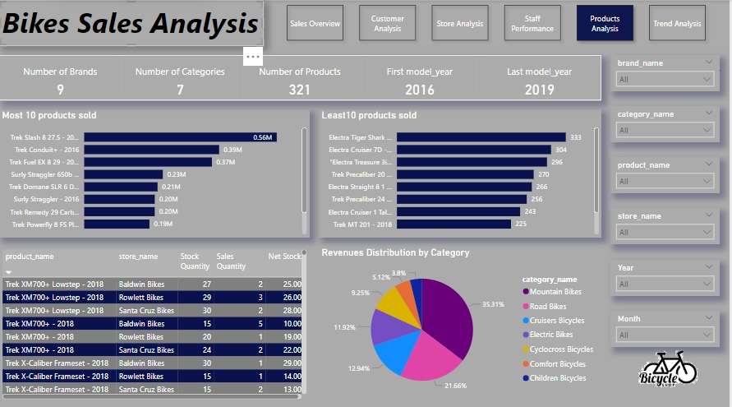
Products
Gumping to products, we had the chance to define our top racing horses, also the almost non-selling ones.
Along with stock analysis aiming to improve inventory management and DOI of Investment.

Slide 14
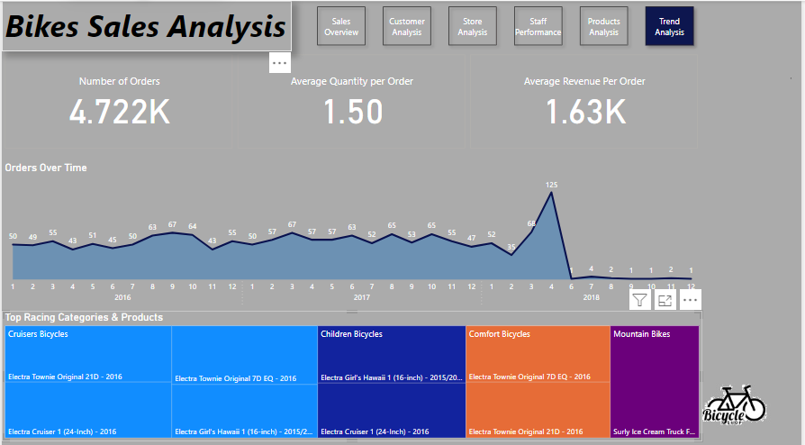
History & Future
Having a final & general look at our history, with a deep focus on changes happened trying to restore success gained in April-2018, aiming to retake the lead in such competitive industry.

Slide 15

Any Questions ?

Slide 16


